Slide 1
Lending club credit risk predictor
Varun arora

Slide 2

agenda
Objective
Understanding the data
Variable interactions
Proposed model
Model Testing and validation
results

Slide 3
Objective
The purpose is to develop an XGBoost model to predict the likelihood of a customer’s default on a credit loan.
Training data used is from year 2015 and tested on out-of-time data from year 2016, each containing 20k records.
Target variable (which we want to predict):
Outcome = 1 for loans that are Charged Off (the lender gave up on collecting) or Late (31-120 days) (overdue, high risk of default).
Outcome = 0 for all other statuses (e.g., Fully Paid, Current, In Grace Period, etc.)
The transformation (from loan_status to Outcome) is done to simply distinguish between good vs bad loans

Slide 4
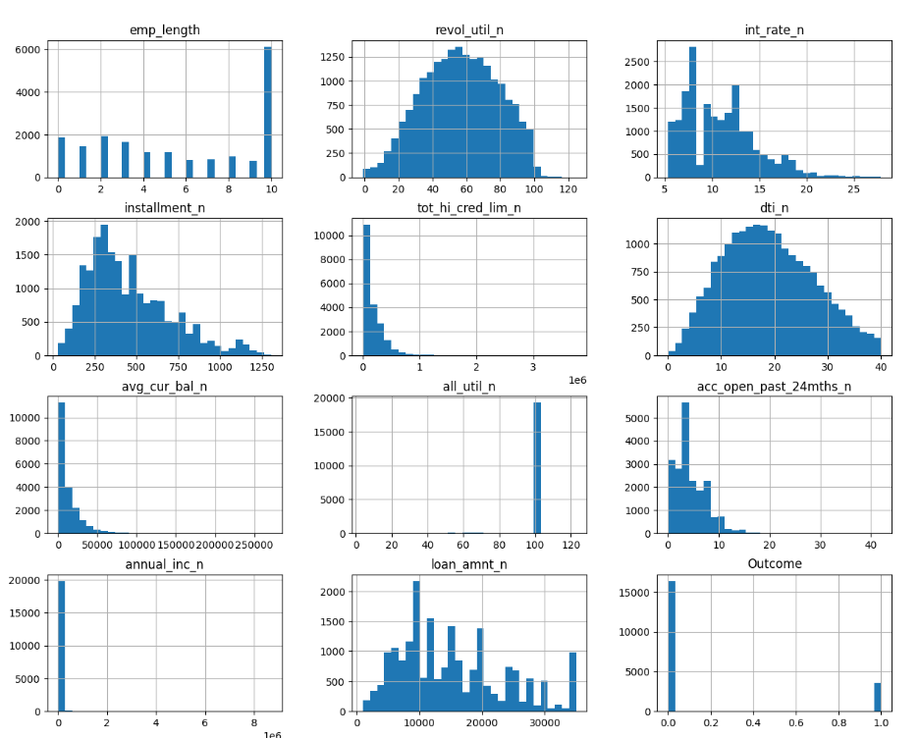
Distribution of Numeric variables
all_util_n - >95% of records have value 100
Outcome: 82% (good), 18% (bad)-unbalanced data
tot_hi_cred_lim_n and avg_cur_bal_n are left skewed
67% of customers have annual income <=50k
emp_length is an ordinal variable

Slide 5
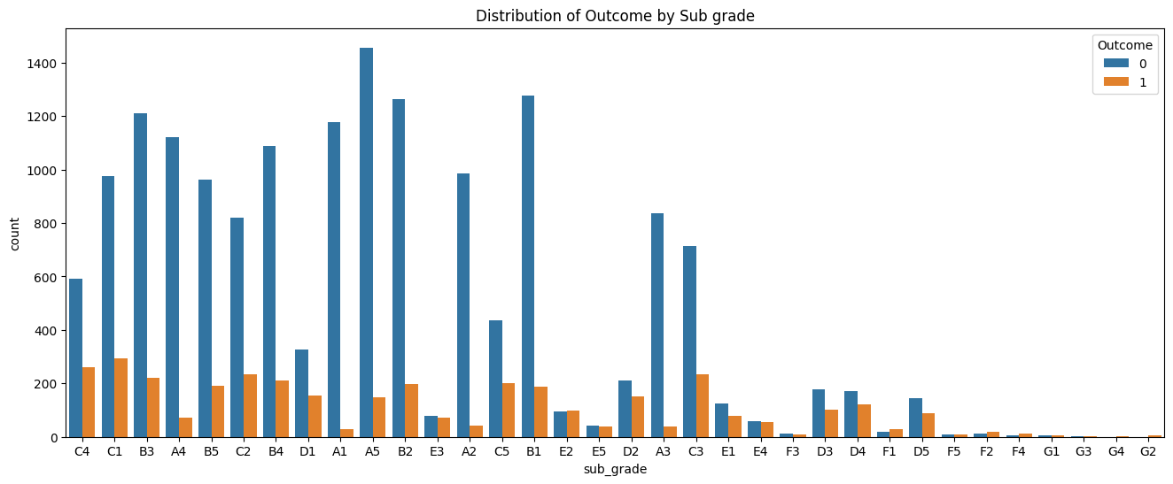
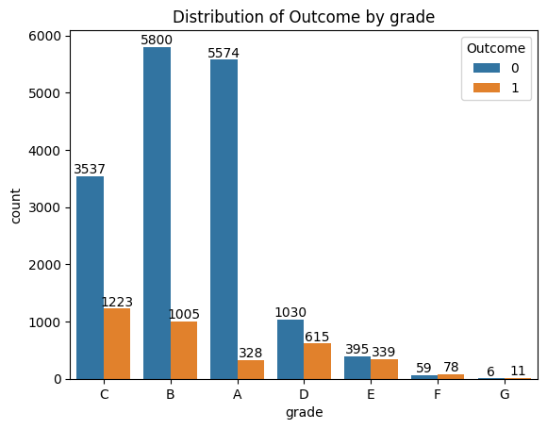
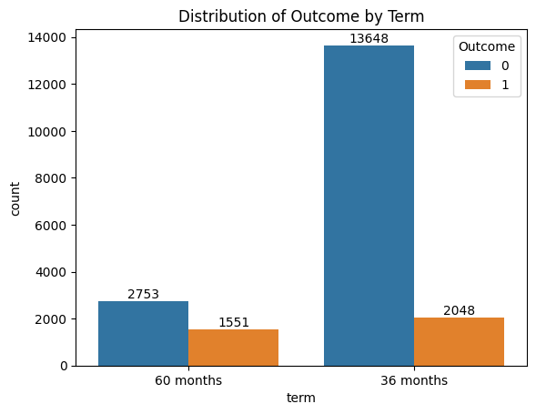
Counts of categorical variables by ‘Outcome’
As the grade and sub_grade deteriorate (from A to F), proportion of bad loan increases
36-month term loans has 13% bad where as 60-month term loans contain 36% of bad loans

Slide 6

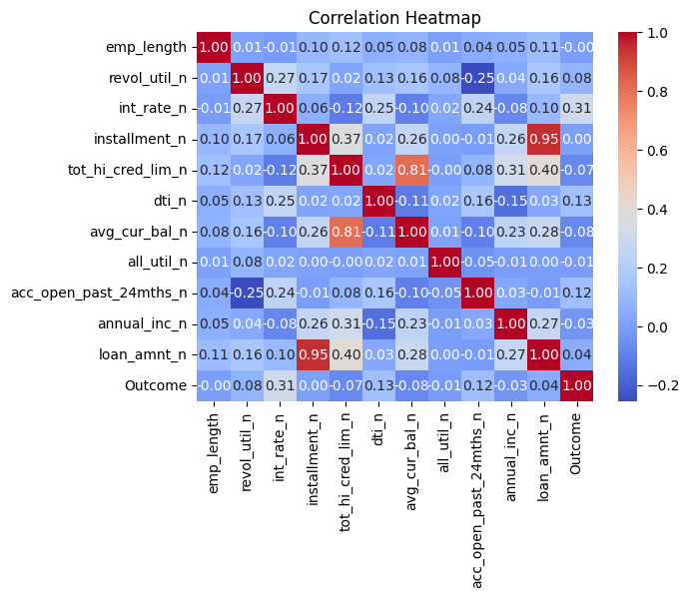
Relation b/w numeric variables
Very high +correlation b/w Loan amount & Installment (0.95)
High +correlation b/w Total high credit limit & Average current balance (0.81)
Moderate +correlation b/w Total high credit limit & Loan amount (0.40)
Relation b/w categorical variables
Cramer’s V value 1 means complete association b/w Grade and Sub grade
Notes:
https://en.wikipedia.org/wiki/Cram%C3%A9r%27s_V

Slide 7
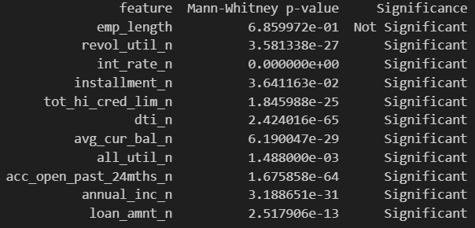
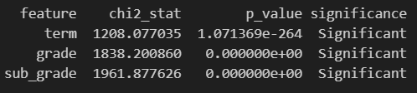
Significance test (Numeric): ‘good’ vs ‘bad’
Non-parametric Mann-Whitney U test was performed (for each numeric variable) to test the null-hypothesis that the two populations (good and bad) are non-distinguishable
Except for emp_length (which is an ordinal, not continuous var), the H0 can be rejected.
For categorical features, Chi2-test was performed to test the significance of association (relationship) between categorical variables and Outcome.
All have a signification association.
Significance test (Outcome vs Categorical )

Slide 8
Proposed model
Algorithm: XGB Classifier
Preprocessing: Label encoding for categorical features, scaling of numerical features not required for tree-based models
Cross-validation: 5-fold CV with 3 repeats using random seeds
Hyperparameters:
Tree depth: 4
Learning rate: 0.03
Number of estimators: 200
Regularization: alpha=0.1, lambda=1.0
Model selection strategy: Combined score based on performance and stability across development and out-of-time datasets

Slide 9
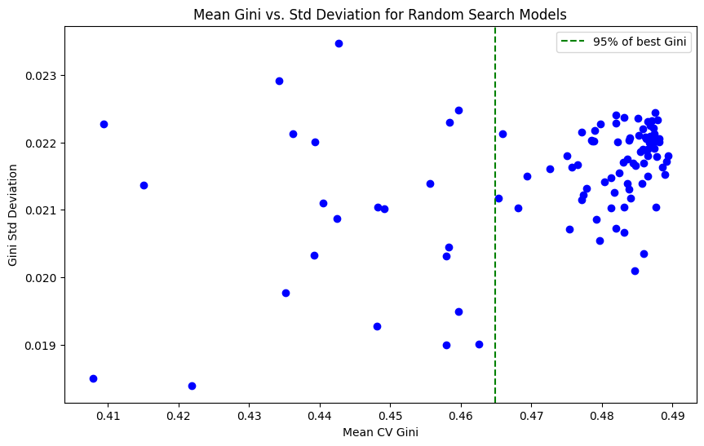
Product benefits

Slide 10
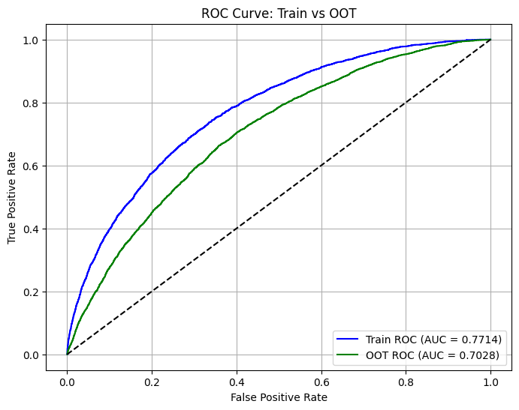
ROC

Slide 11
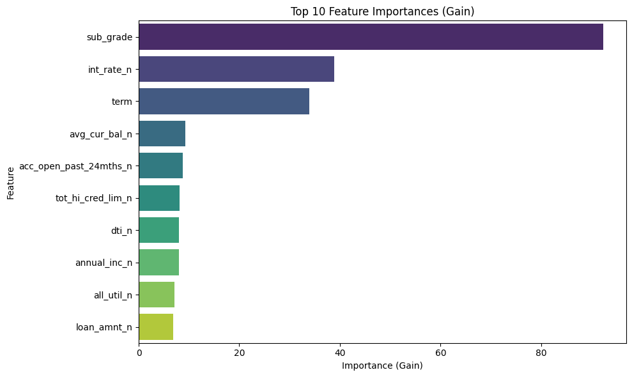
Feature importance

Slide 12
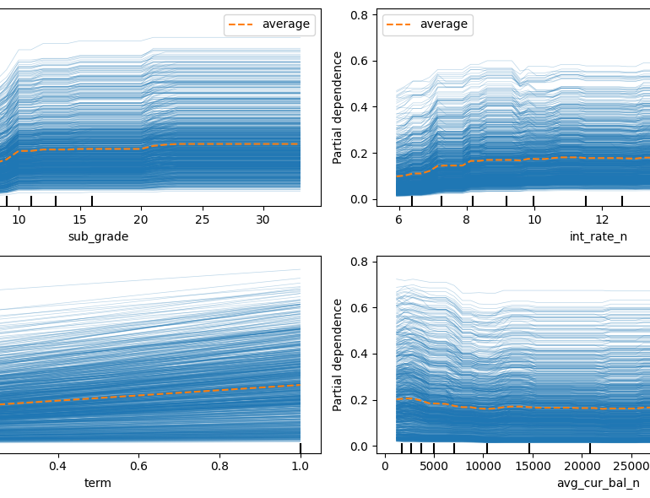
PDP and ice plots
sub_grade: As the sub grade increases (deteriorates), the credit default increases up to a certain point, then stabilizes. There is sharp increase a couple of times in between which is probably indicates grade boundaries.
int_rate: With an increase in int_rate, there is a gradual increase in the default. Data is evenly distributed as observed by the rug ticks.
term: It has a constant slope which means a constant increase in default with term. Rug ticks suggests data is concentrated along the extereme ends.
avg_curr_bal_n: default decreases initially indicating a negative relation and the stabalizes or rate of change is quite slow.

Slide 13
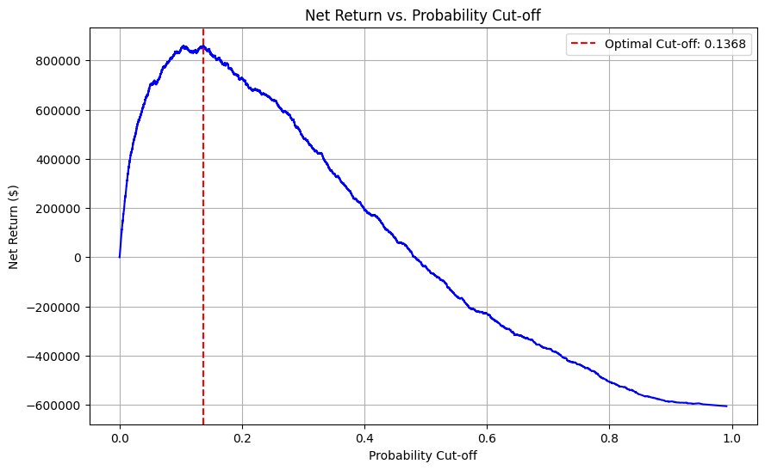
Optimal threshold
sub_grade: As the sub grade increases (deteriorates), the credit default increases up to a certain point, then stabilizes. There is sharp increase a couple of times in between which is probably indicates grade boundaries.
int_rate: With an increase in int_rate, there is a gradual increase in the default. Data is evenly distributed as observed by the rug ticks.
term: It has a constant slope which means a constant increase in default with term. Rug ticks suggests data is concentrated along the extereme ends.
avg_curr_bal_n: default decreases initially indicating a negative relation and the stabalizes or rate of change is quite slow.

Slide 14
Summary
With this product, Adatum Corporation is positioned for success in the dynamic market.
With a focus on innovation, user experience, and strategic growth, we anticipate reaching new heights in the coming year.
Our commitment to user satisfaction underscores every aspect of our operations
Strong market positioning
Robust growth strategy
Innovative product development
Commitment to user satisfaction

Slide 15

Thank you
Varun arora| linkvarun@gmail.com | +61-420768193

